Slide 1


THE POWER
OF BRANDING
By : Zulfa Irbah

Slide 2


What is branding?
Branding is the process of creating a unique and recognizable identity for a product, service, or company. It involves crafting a distinctive name, logo, and overall image to differentiate it from competitors and leave a lasting impression on consumers. Effective branding helps establish trust, build customer loyalty, and convey the values and personality of the brand.

Slide 3
Definiton by Experts
Branding is the encapsulation of a company’s mission statement, objectives, and corporate soul as expressed through the corporate voice and aesthetic.
A brand is a reason to choose.
CHERYL BURGESS
MARGIE CLAYM
A brand is a name, term, sign, symbol, or design or a combination of them, intended to identify the goods and services of one seller or group of sellers and to differentiate them from those of the competitor.
Branding is the representation of your organization as a personality. Branding is who you are that differentiates you.
DAVE KERPEN
PHILLIP KOTLER

Slide 4
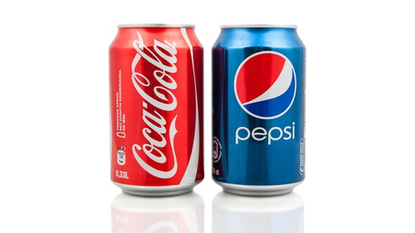
Coca-cola vs Pepsi
The Coca-Cola and Pepsi rivalry, often dubbed the "Cola Wars," began in the late 19th century when both companies were founded. Coca-Cola was created by Dr. John Stith Pemberton in 1886, and Pepsi-Cola was concocted by Caleb Bradham in 1893. What ensued was a fierce competition that would span decades and shape the beverage industry.

Slide 5

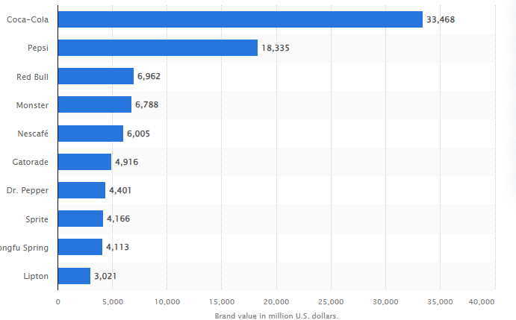
Most valuable soft drink brands worldwide in 2023, based on brand value
Source : Statista

Slide 6
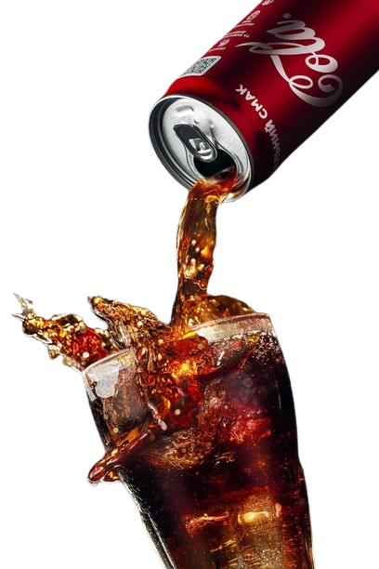
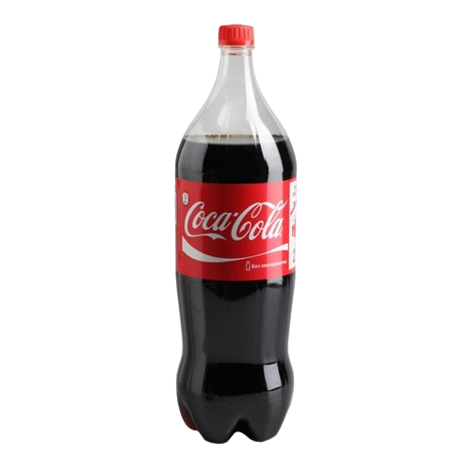
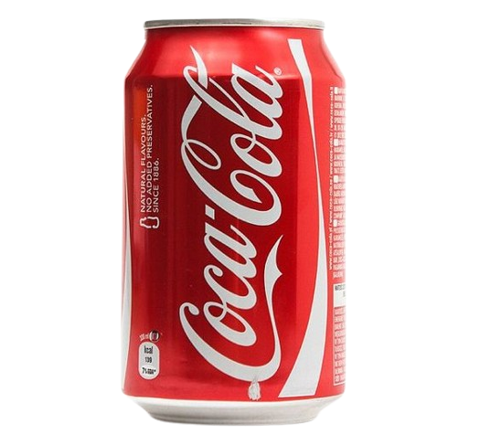
What makes coca-cola different?
Coca-Cola is available in almost every corner of the world. Its global reach and availability have contributed to its brand strength.
Coca-Cola has a history of strategic partnerships and sponsorships, including events like the Olympics and FIFA World Cup. These partnerships help increase brand visibility and association with positive experiences.
Coca-Cola continually innovates its products and packaging to stay relevant in the market.
Coca-Cola maintains a consistent taste and quality of its product.
Coca-Cola engages in various community and social responsibility initiatives.

Slide 7
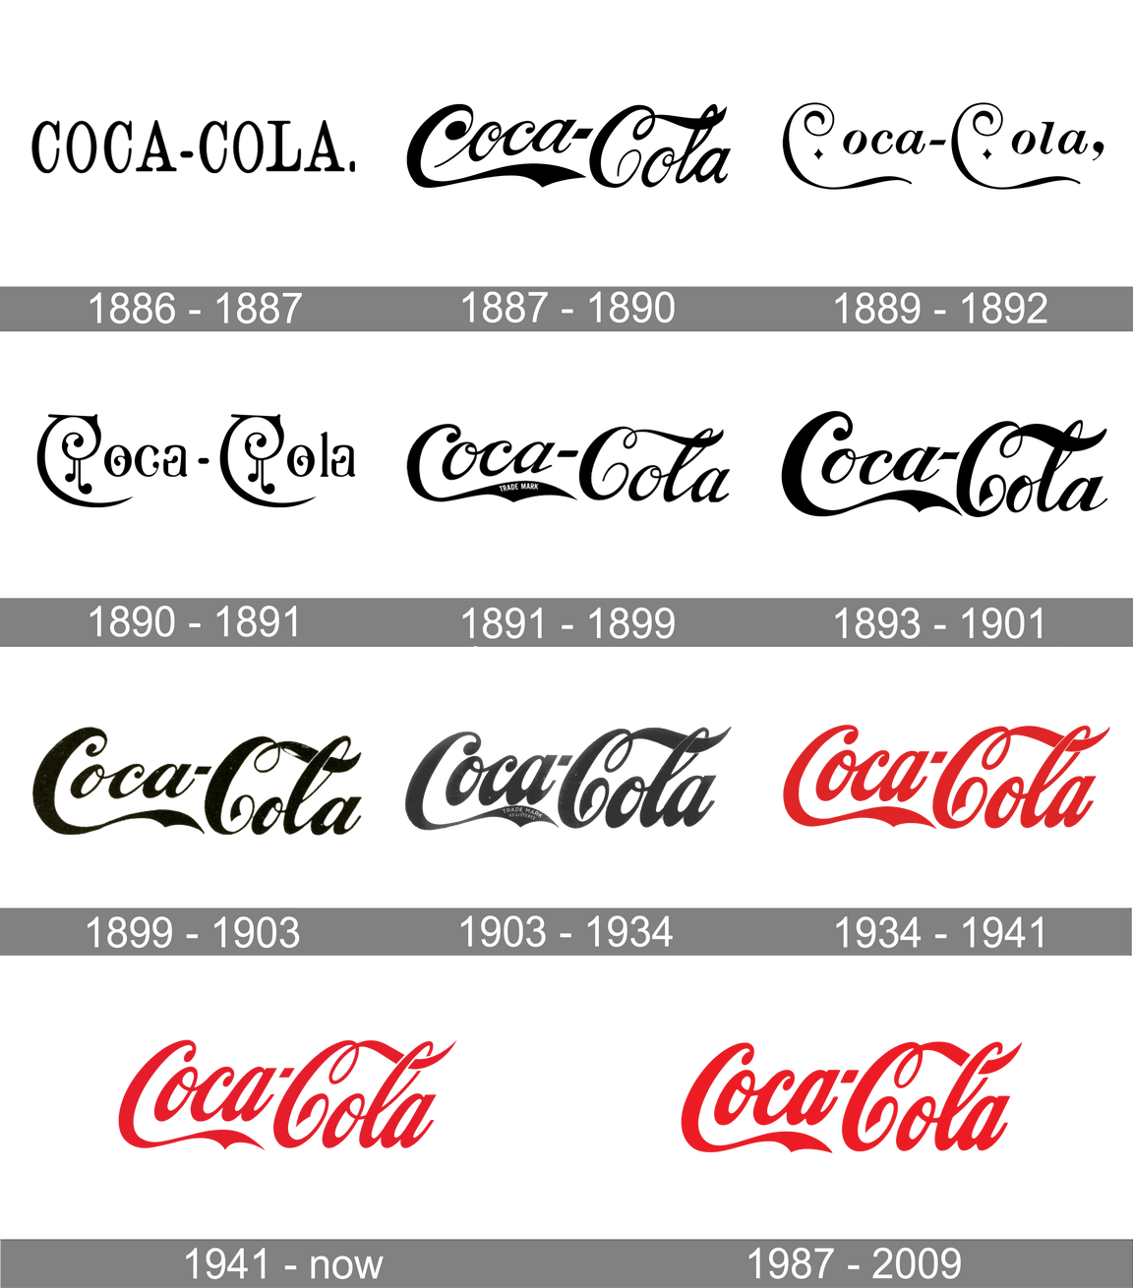
What makes coca-cola different?
Coca-Cola has maintained a consistent brand image over the years. The iconic red and white logo, the distinct contour bottle shape, and the memorable tagline "Open Happiness" contribute to a strong and recognizable brand.

Slide 8
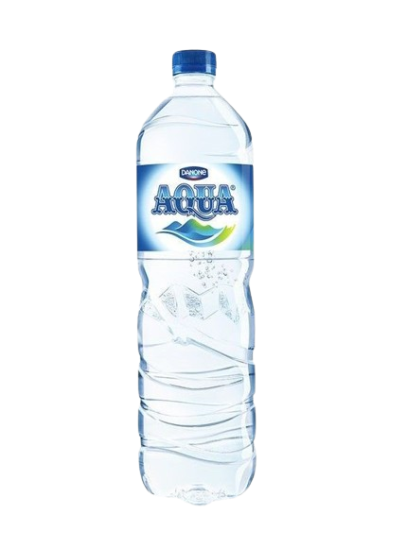
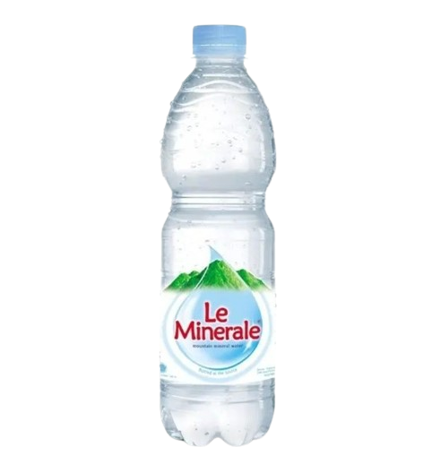
Le Minerale vs Aqua
Established in 1973, Aqua is a the most renowned mineral water brand in Indonesia. Over the years, numerous other brands have emerged, including Le Minerale, which started production in 2015. Currently, Le Minerale has achieved significant popularity in Indonesia, establishing a strong brand identity that positions it as a formidable competitor alongside major brands like Aqua.

Slide 9
How can Le mineral compete well in the market and become Aqua’s strong rival??
Le Mineral has successfully established a robust brand image in the market through a memorable tagline. “Kayak ada manis-manisnya”
The product lives up to the promised quality standards, with the taste of Le Minerale water being perceived as sweeter compared to other mineral waters.

Slide 10

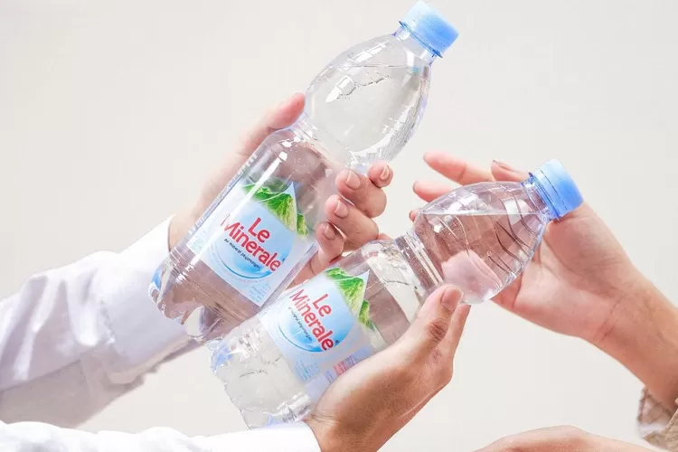
How can Le mineral compete well in the market and become Aqua’s strong rival??
The brand ambassador, Dr. Reisa Broto Asmoro, an influencer in the health sector, plays a crucial role in fostering trust among the audience.
The bottle design is stylish and modern, enhancing the appeal of this product.

Slide 11

Wardah Cosmetics
Wardah Cosmetics is a prominent Indonesian beauty and skincare brand that has gained widespread recognition for its commitment to providing halal and high-quality products. Established in 1995, Wardah focuses on offering a comprehensive range of cosmetic and skincare items, including foundations, lipsticks, eyeliners, and skincare essentials. Wardah takes the crown as the most popular cosmetic brand in Indonesia (InvestinAsia, 2023)

Slide 12

What makes Wardah so popular?
Wardah has positioned itself as a halal and natural cosmetics brand, catering to the predominantly Muslim population in Indonesia. This approach aligns with the cultural and religious values of the target market, fostering a sense of trust and authenticity.

Slide 13
SUMMARY
In conclusion, to make a brand successful, it's important to create a unique and memorable identity that makes a product stand out from others. A good brand not only offers quality as promised but also makes sure it has a special and easily recognizable presence in the market.

Slide 14
Thankyou!!!

